Slide 1
Principles in Patterns (PiP): key achievements
George Macgregor, University of Strathclyde
Pecha Kucha presentation
JISC Institutional Approaches to Curriculum Design Aston University, Birmingham, 22 May 2012

Slide 2
Before PiP…
Graeme Pow, CC BY-NC-SA 2.0
Notes:
Strathclyde typified by stormy waters before PiP began
Curriculum design and approval process largely undocumented, mysterious, lacking transparency and misunderstood
Low adherence to University policies on design, exacerbated by disparate faculty practice which often failed to adhere to some basic principles of curriculum design
Curriculum approval process arcane, unresponsive, onerous, and plagued by inefficiency and ineffectiveness – and myth
Appalling information management and workflow issues

Slide 3
Addressing baselining issues
Chandra Marsono, CC BY-NC-SA 2.0
Notes:
Achieving a measure of the principal curriculum design and approval problems was the focus of the baselining exercise early in the project
Many issues identified as impeding the approval process; but all could be collapsed into five main issues:
Process bottlenecks
Poor feedback looping
Absence of version control
Absence of any central database of curriculum designs
Form size and lack of guidance
All have been addressed by PiP and many resolved by C-CAP.

Slide 4
Demonstrable impact on process: change and improvement
“Not everything that counts can be counted,
and not everything that can be counted counts…”
David Saddler, CC BY 2.0
Notes:
Addressing the baselining issues has in itself improved process; but evaluation has evidenced other process improvements and increased efficiency
C-CAP has:
Implemented improved process communication mechanisms
Automated entirely or rendered interactive some bureaucratic activities
Improved process visibility to all stakeholder groups
Implemented process parallelism
Reduced the number of human transition delays
C-CAP supports a reduction in defects by employing system logic to detect common drafting errors which are often the cause of approval delay or rejection.
But measuring impact on process can be problematic and a future achievement of the project is to develop better means of monitoring process efficiency, something that is difficult to do owing to the length and size of the process.

Slide 5
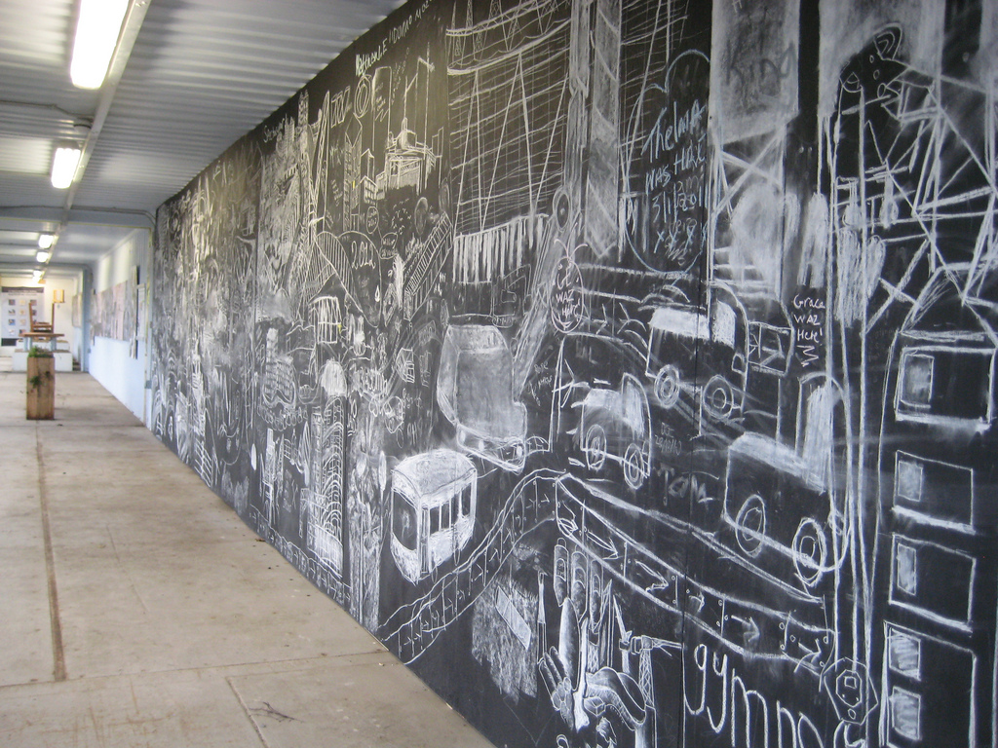
Supporting better curriculum design
Wiredcanvas, CC BY 2.0
Notes:
C-CAP has enabled better adherence to pedagogical principles by promoting best practice in curriculum design.
Previous curriculum design practice was inconsistent and often failed to demonstrate some basic principles of curriculum design, as acknowledged by educational literature.
C-CAP has replaced faculty specific curriculum design templates and provides a system that better promotes good design practice while simultaneously capturing the information necessary to verify academic quality and monitoring.
The system also employs system logic and context sensitive guidance to support academic during the design process, particular areas relating to assessment and constructive alignment.
For some this may not sound particularly radical, but such technology supported solutions to curriculum design can enable subtle adjustments to the way in which academics design curricula. These adjustments may not be “radical” in education terms, but they can be “radical” in institutional terms by setting a minimum level of curriculum design quality and ensuring adherence to acknowledged curriculum design principles, which would otherwise be ignored. In some cases it can also inspire reflection among lecturers.

Slide 6
Supporting better collaboration
Ranjith Shenoy, CC BY-NC-SA 2.0
Notes:
PiP has certainly brought about better collaboration.
Through C-CAP academic writing teams can collaborate on new curricula in way that was hitherto impossible; geographically distributed academic teams – including collaborative partners around the globe - can work-up proposals online collaboratively, saving as they go and drafting when it is convenient for them .
Academic, faculty and academic quality review has also been rendered more collaborative by enabling directed feedback to be delivered to writing teams via C-CAP. Essentially this is an annotation tool enabling reviewers to comment on specific section of the proposal. These comments are saved for other reviewers to see in order to maintain a consistent message. These comments are saved to provide a formal record of the reviewing process (resolving a previous criticism).
More generally, PiP as a project, but its principal technical output, C-CAP, has been a catalyst for greater collaboration and a willingness to address the curriculum design and approval issues. Stakeholders have been brought together at meetings to discuss PiP and C-CAP – and these are stakeholders who would otherwise never fraternise with each other.

Slide 7
Process transparency
Catwomancristi, CC BY-NC-SA 2.0
Notes:
Throughout the lifetime of the project a lack of process transparency surrounding curriculum design and approval has been identified as a particular problem and an inhibitor of change.
Improving transparency has been a particular achievement of the project.
Technical solutions have improved process visibility considerably, e.g. through the use of approval process status indicators for proposals, visible to all stakeholders.
More fundamentally, by virtue of being a single curriculum design and approval system, C-CAP has come to embody the approval process and has decoded and formalised tacit practice; it makes explicit to stakeholders what the process is, supports stakeholders through the process and keeps them informed of process status, and provides guidance materials. Because prior to this there was very little guidance on the design or approval process, or what was even expected from stakeholders in order to make the process function effectively. Note previous guidance.

Slide 8
Incremental, emergent continuous improvement
Randy Son of Robert, CC BY 2.0
Notes:
Institutional reorganisation and a general lack of appetite for change which can often typify public sector organisations was the scenario at the University of Strathclyde.
Recognising the difficulties in effecting wholesale redesign or change, the philosophy adopted by the project was one that emphasised incremental, emergent process change and improvement.
Proposing improvements and technologies which point in a direction that management and key stakeholders feel they can support and champion.
This has been most obvious during the piloting of C-CAP. Piloting has facilitated meaningful discussions with the people who are capable of effecting longer term change because they can influence institutional policy, such as the University’s Education Strategy Committee (who are capable of influencing curriculum design policy) and SEES (who have been motivated to support and champion the institution wide embedding of C-CAP.
The incremental change has brought about a change in mind set….

Slide 9
Formal techniques
Jared Zimmerman, CC BY-NC-ND 2.0
Notes:
Geodesic domes are an interesting example of the success of a formal technique to build strong structures from lightweight materials, focusing more of the structure of the build… i.e. power of triangulation.
Perhaps an unexpected achievement of the project is the continued success in using a suite of formal techniques in many aspects of the project’s activity.
This has included:
Formal approaches to the modelling of business process using BPMN and ISO5807, as well as process analysis.
Adopting agile and incremental systems design methodologies in the development of C-CAP
Lean Six Sigma techniques such as DMAIC, SIPOC, Kano model, Pareto analysis
A structural evaluative approach, using formal methodological techniques such as heuristic evaluation, System Usability Scale (SUS), qualitative benchmarking, Most Significant Change methodology.

Slide 10
Catalyst for SLEEK change…
Éole Wind, CC BY-NC-SA 2.0
Notes:
The incremental, emergent change mentioned earlier has – as we approach the end of the project – brought about a change in mind set at the University.
PiP has been a catalyst for wider business process improvement initiatives across the institution, with many of the same formal techniques being used.
These initiatives have formed part of a wider project (SLEEK) which is seeking to formalise HE specific methodologies for process improvement to help the institution meet strategic objectives
Developing staff across the University to empower them to facilitate change and use these methodologies in their professional practice as a matter of course.
Changing the DNA of the institution.
At this moment over 40 SLEEK specific projects are underway, in areas as disparate areas of University business.

Slide 11
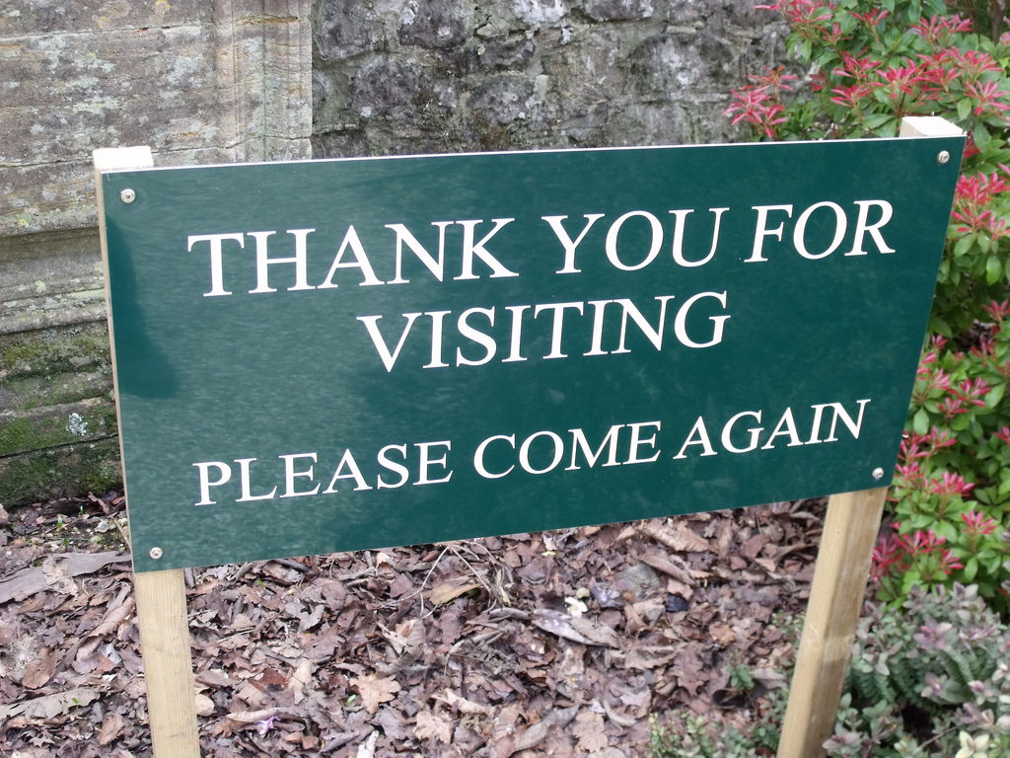
Principles in Patterns (PiP): http://www.principlesinpatterns.ac.uk/
Ell Brown, CC BY 2.0

